Slide 1


Imagine the Possibilities:
A Path to Employment Success
Sean Roy - TransCen

Slide 2
Today’s Agenda
Why are we talking employment?
Employment: Background and possibilities
Seeing things in a new way
Preparing for employment success
Address concerns: Social Security benefits
Action steps
Questions and connections
Remember to use your worksheet as we move along

Slide 3
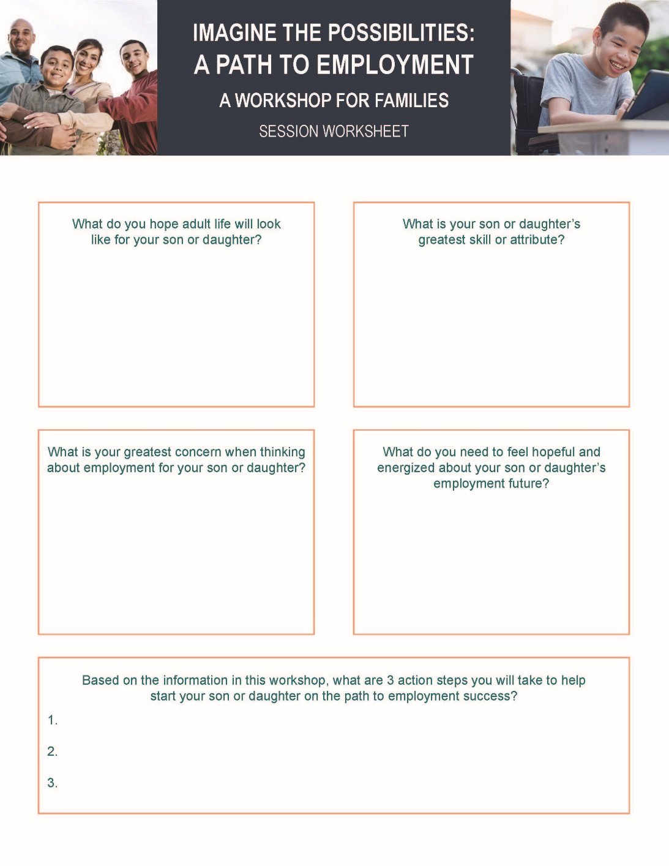
WORKSHEET QUESTION 1
What do you hope adult life will look like for your family member?

Slide 4

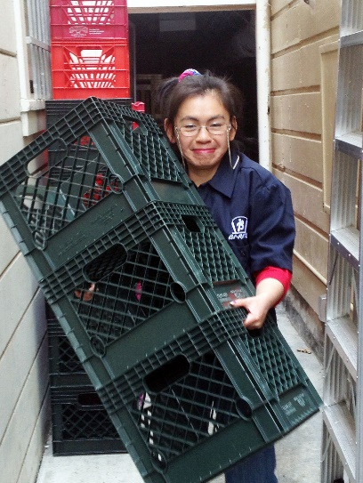

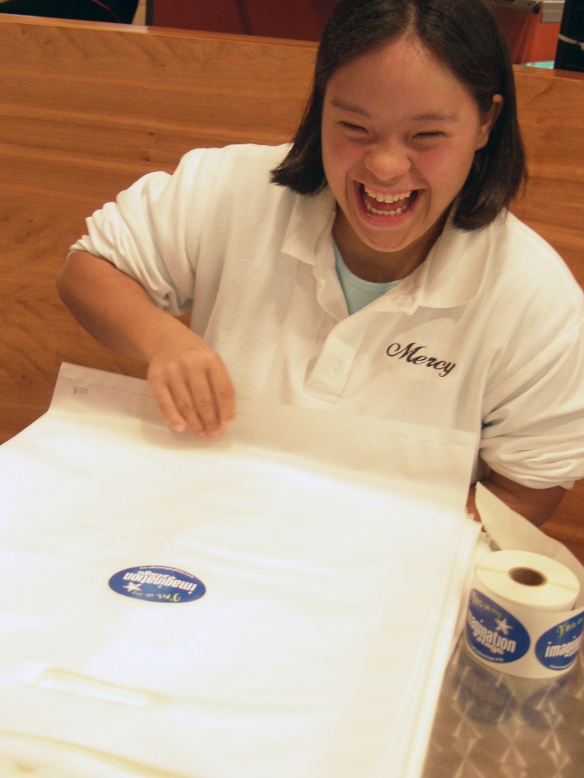


Today, People with Disabilities…

Slide 5
But There is Still Work to be Done…
There is still a long way to go before people with disability experience equality of opportunity in the US.
Employment rates
Poverty
Housing options
Social, recreational, relationships
A respected voice
Determine own futures

Slide 6
Employment:
So Much Is Possible

Slide 7
Employment: Core Concepts
1
2
Everyone can work!
Work looks differently for everybody
Employment should be rooted in what your family member wants to do
3

Slide 8
“Employment First”
It is the policy of the state that opportunities for integrated, competitive employment shall be given the highest priority for working age individuals with developmental disabilities, regardless of the severity of their disabilities.
California Assembly Bill No. 1041 (2013)
Individual – Not in a group or enclave
Integrated – Alongside those without disabilities, with opportunities to interact
Employment – In the general workforce, on the payroll of a business or self-employed
Minimum Wage – At or above minimum wage or at industry standard wage

Slide 9
Why Should Your Family Member Work?
“The growth in his personal development, confidence and maturity became apparent very soon after he started working. Everyone in his family took notice and was delighted with the happy adult my son had become.”
– Bay Area Parent –
It is what is expected of adults
Socialization
Self-worth (dignity)
Purpose
Money
Promotes mental health
Because they can!

Slide 10

New Reality
More attention to health and safety
More time in front of a computer or device
Limited access to supports for periods of time?
Certain job sectors will bounce back and employees will be needed.

Slide 11
Seeing Your Family Member in a New Way

Slide 12
How do We Define Expectations?
“Expectations”
are a belief that someone will or should achieve something; that something will happen or is likely to happen in the future.
“High Expectations”
are the belief that a person with a disability (or other barrier) can achieve the same life and have the same life choices as everyone else.
Notes:
Judith

Slide 13
Where Do Low Expectations Come From?
Society’s perceptions about the impact of disability
Feelings about having a family member with a disability
What we are told by others
The secret is seeing that people with disabilities can do great things, and not letting other people’s ideas impact your family member’s ability to make lives for themselves.

Slide 14
The Importance of Having High Expectations
Families set the bar for how the rest of the world sees their family member with a disability.
Avoiding restrictive programs or placements
Lives lived in the community
Lives based on the dreams your family member has for themselves
Seeing that risk is good and failure can be constructive

Slide 15

The Balancing Act

Slide 16

Patience is Key

Slide 17

What is Success?
Think of a couple things that you would not be successful at on your first try.
Success in employment is an ongoing process and will look different for everyone.
Hours worked
Tasks
Tolerance
Recognize and celebrate progress!!

Slide 18
WORKSHEET QUESTION 2
What is your family member’s greatest skill or attribute?

Slide 19
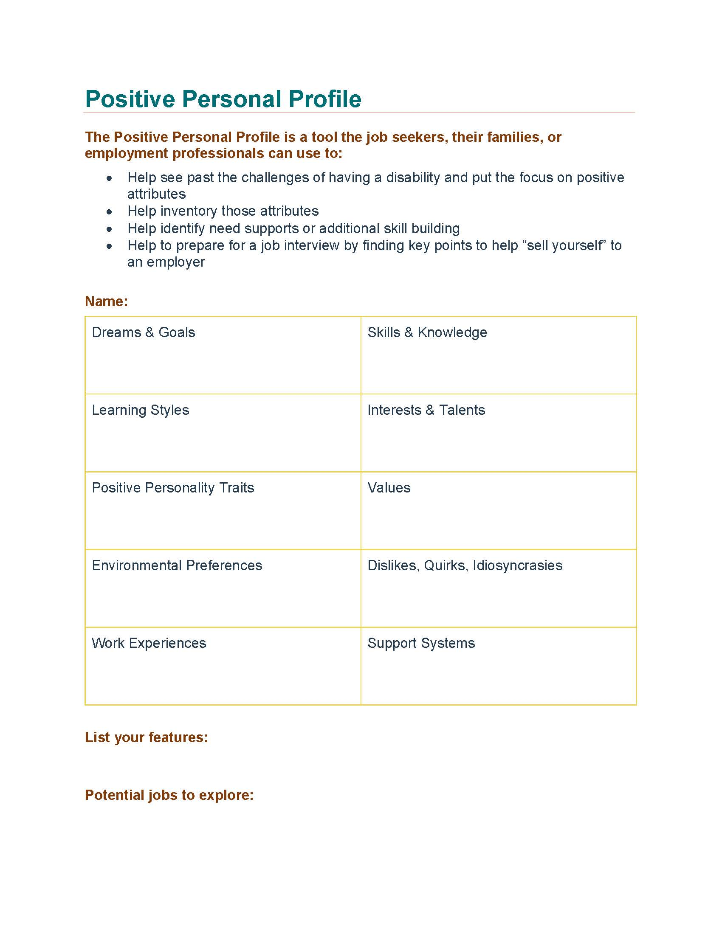
HELPFUL TOOL
Positive Personal Profile

Slide 20
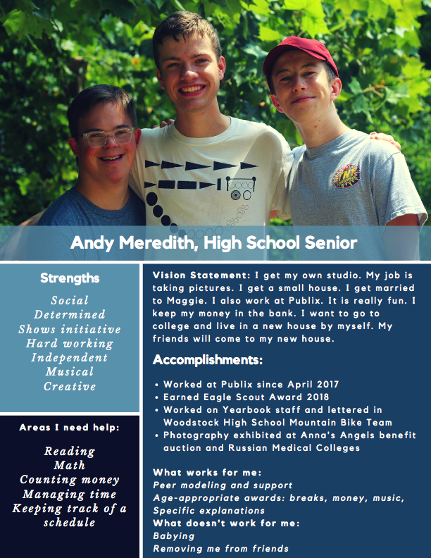
Building a Vision Statement
https://hdi.uky.edu/employment-checklists

Slide 21
Preparing for Employment Success

Slide 22
The Power of Work Experiences
One of the best predictors of employment success for people with disabilities is having meaningful work experiences while in high school.
Informational interview
Job Shadowing
Volunteering
Internships
Paid entry-level job

Slide 23

Using Your Networks
Use the people you know to help find work experience opportunities.
Friends
Family
Places you do business
Neighbors
People you are in clubs with, worship with, or serve with

Slide 24
Building Responsibility
Finding ways for young people to have responsibilities helps them be good employees.
Chores
School work
Soft Skills
It’s OK for young people to take risks and to experience failure. The goal is to have them give a good effort.

Slide 25







Getting Involved

Slide 26
School and Employment
The high school and transition years are the perfect time to focus school programs on preparing for employment.
Are skills needed for work included as goals in the IEP?
Career exploration
Functional skills and soft skills
Work experiences
Quick Tip: Parent advocates can help coach you on asking for employment-focused activities in the IEP.

Slide 27
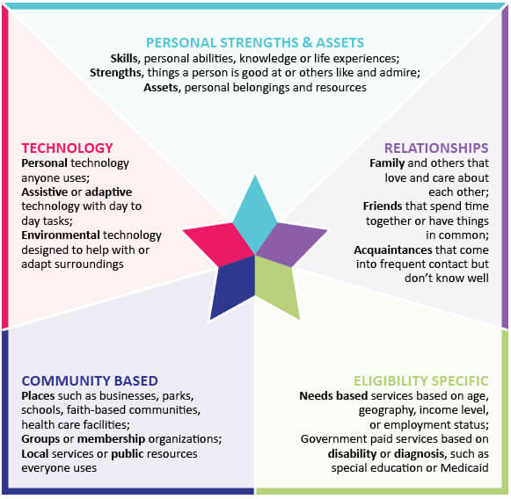
Consider ALL Possible Supports
Only 25% of persons with I/DD will access formal services
Consider community-based options, technology solutions, and personal relationships as possible employment supports

Slide 28
Discussing Your Concerns

Slide 29
Having Questions or Concerns is Normal
When thinking about a real job in the community for your family member, is there anything that makes you worried or concerned?
Vulnerability
Safety
Can they do the job?
Who will hire them?
Will they lose benefits?

Slide 30
WORKSHEET QUESTION 3
What is your greatest concern when thinking about employment for your family member?

Slide 31
Myths about Employment
Misinformation and misunderstanding can hold us back from considering employment.
People with disabilities don’t work fast enough (MYTH)
Employees with disabilities won’t be accepted by co-workers (MYTH)
Sheltered work is safer than community jobs (MYTH)
People who leave workshops lose their friends (MYTH)
People with significant disabilities don’t need to work (MYTH)
Don Lavin – Strengths at Work

Slide 32
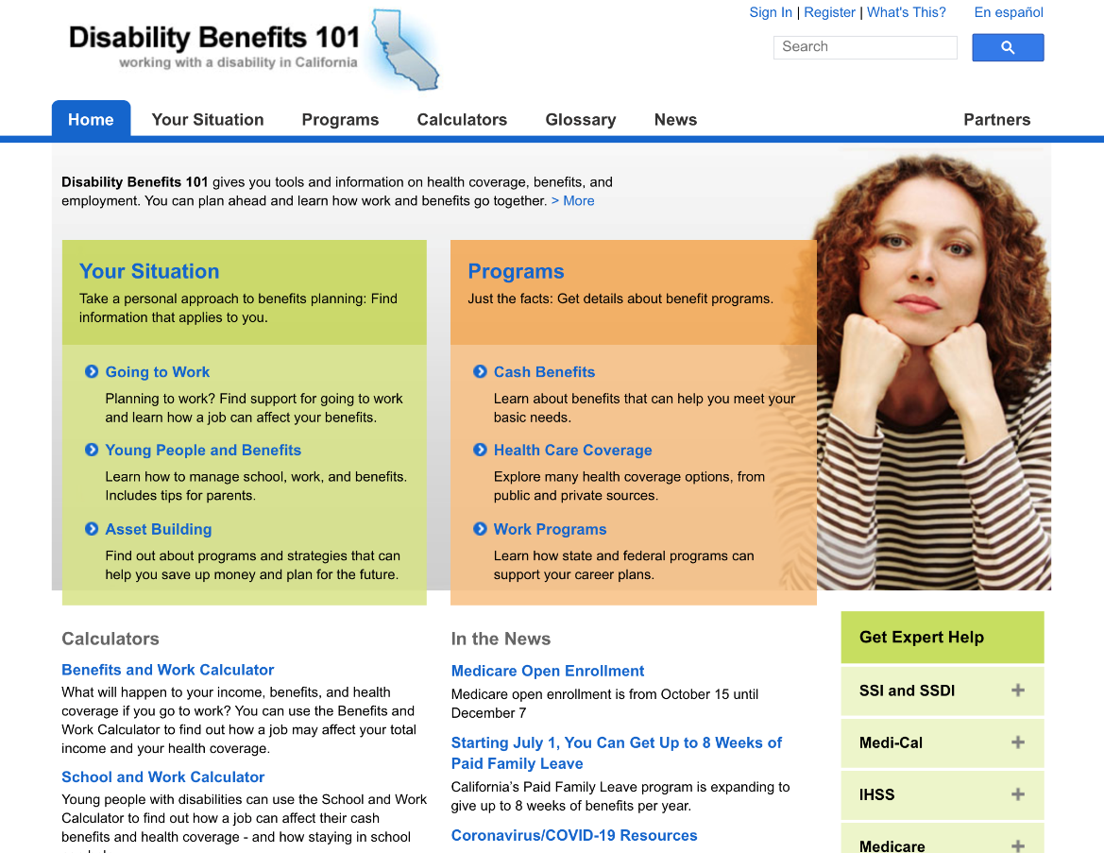
Social Security Benefits: Myths and Resources
MYTHS
Getting students on SSI will take care of everything
People who choose work will lose disability and healthcare benefits
People can live independently in the community on what SSI provides
https://ca.db101.org

Slide 33
WORKSHEET QUESTION 4
What do you need to feel hopeful and energized about your family member’s employment future?

Slide 34
Action Steps: Getting Started

Slide 35
WORKSHEET QUESTION 5
Based on the information in this workshop, what are 3 action steps you will take to help start your family member on the path to employment success?

Slide 36
Takeaways
Have high expectations and set a vision for employment
Celebrate and cultivate strengths and interests
Recognize challenges and address them
As a family member, find the information and support you need

Slide 37

Questions

Slide 38
Contact Information
Omar Gomez
Harbor Regional Center
Omar.Gomez@harborrc.org
(310)543-0142

