Slide 1
A Warm Transition from Alternative Services
Heather Diaz, Director of Community Services
Mercedes Lowery, Manager of Community Services
Brenda Bane, Provider Relations Specialist
Judy Wada, Chief Financial Officer

Slide 2
State Budget Ends Alternative Services
California's 2022 Budget authorized continued provision of Alternative Services until 12/31/22.

Slide 3
Alternative Non-Residential Services
Traditional services are defined as an individual receiving the service and support in the same frequency and duration as prior to the pandemic. Traditional services can be delivered through a combination of different service modalities, not only through on-site services.
Alternatives services are defined as a change in the frequency and duration of the service that the client was being provided prior to the pandemic. Alternative Services can be provided through different service modalities including on-site services. Can include different supports/services to respond to any new needs.

Slide 4
Alternative Non-Residential Services
ASDM Monthly Rate
Subcode A@____
Clients may change from Alternative Services to Traditional. If change happens mid-month, providers will bill using the Alternative Services Monthly Rate
If a client wants a combination of Traditional and Alternative Services, provider should bill using the Alternative Services Rate
Duplicate Authorizations for Alternative vs Traditional Services
Providers can only bill using one authorization per client per month

Slide 5
Rate Study Implementation Acceleration
25% of difference between March 31, 2022 rate and applicable rate model/”benchmark rate”. April 1, 2022 – DONE!
50% of difference between March 31, 2022 rate and applicable rate model/”benchmark rate”. January 1, 2023
Full implementation of rate models with 2 payment components: 90% of rate model/”benchmark rate”, quality incentive program up to 10% - July 1, 2024

Slide 6
Rate Study Implementation
Rate Study Adjustments effective April 1, 2022
HRC Rate Letter
Vendor Excel File
Alternative Services Nonresidential Monthly Rates are not subject to the rate adjustment.
Service Codes:
055 505 805
110 510 950
111 515 952
116 520 954
Email questions to: ratesquestions@harborrc.org
Please include your vendor number and service code

Slide 7
Alternative Services Authorizations
Alternative Services Authorizations must end by December 31, 2022
Starting October 1, 2022, new Alternative Services authorizations will end on 12/31/2022 and a corresponding Traditional Services authorization will be created.
At a later date, existing Alternative Services authorizations with end dates after 12/31/2022 will be terminated and corresponding Traditional Services authorization will be created.

Slide 8
Prorated Billing
If an individual cannot participate for a full session, please consider prorated billing. For example, if a full session is normally 4 hours and the individual participates on Zoom for 2 hours, you can bill 0.5 sessions.

Slide 9
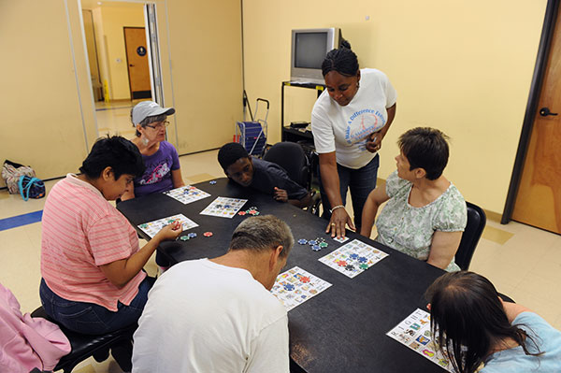
Regional Center Vendors Offering Alternative Services
HRC Community Services Department will be sending out a Re-Engagement Plan after this presentation to service providers on their plans for resuming Traditional Services, including service delivery modalities, and the barriers to resuming Traditional Services, including staffing vacancies, client choice, etc.
HRC is also interested in knowing if a provider does not intend to return to offering services as they were pre-pandemic.
HRC is expressing the need for programs to staff up effective 11/1/2022. This will allow for more cohesive planning amongst the day programs, transportation agencies, and Case Management for those clients that will be resuming Traditional Services in-person and on-site.

Slide 10
Please send your completed plan to this e-mail: HRCCommunityServices@harborrc.org

Slide 11
Please send your completed plan to this e-mail: HRCCommunityServices@harborrc.org

Slide 12
COVID Precautions—Testing

Slide 13
COVID Precautions—PPE
Available PPE:
N95 masks
Hand sanitizer - 16 oz. pump
Isolation gowns
Face shields
Cloth facemasks
Limited resources:
Surgical masks
Gloves (sizes available from small to x-large)
Hand sanitizer – gallon
Clear face masks
Email hrcpperequest@harborrc.org
A form will be emailed to you and you will be contacted to arrange pick up.

Slide 14
Thank you for participating today.
If you have additional questions, please send them to HRCCommunityServices@harborrc.org

